Slide 1



TAM
Teacher Assistant Manager
A Telegram Bot

Slide 2


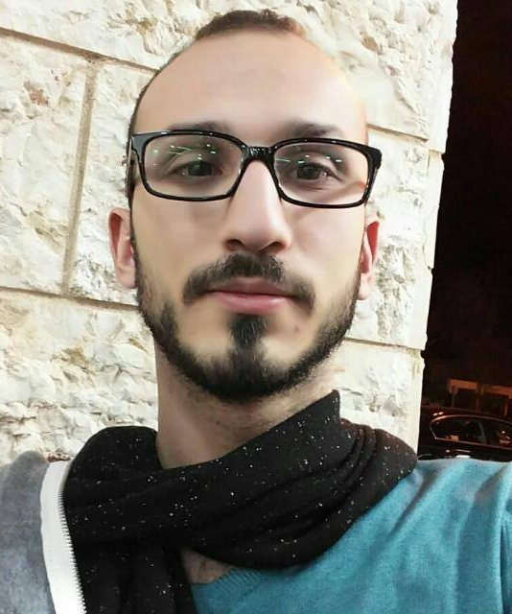
Infographic Style
Meet Our Team
Basil Sgier
Abeer Dow
Aseel Nassar
Age: 25
University: Haifa University
Age: 25
University: Haifa University
Age: 24
University: Technion

Slide 3
The Problem
01
Repetitive Questions
Since many students’ parents have similar problems, the same questions get asked multiple times, causing the teachers to answer questions repetitively.
02
Slow response time
Teachers can’t reply to questions 24 hours a day. What’s more, on weekends or holidays parents might not get an answer at all.

Slide 4
Our Solution

Slide 5

Simple Platform Telegram Bot
Immediate response without overwhelming the teachers
Our bot answers the frequently asked questions from parents or students.
Simple to use
It’s a texting based platform, that makes it intuitive to use like any other chatting app.
Available to everyone
Our bot is available for free in the telegram app on desktops, laptops and smartphones.

Slide 6
Challenges
Making our bot identify questions that have been asked in different ways
D
D
D
D
D

Slide 7
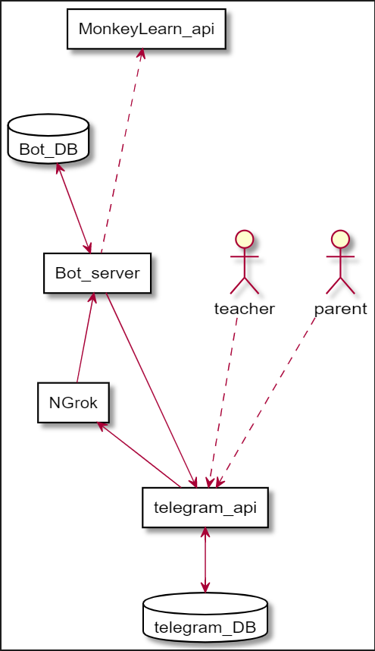
Facing the challenge
Using MonkeyLearn API to match keywords to previously asked questions.

Slide 8
What’s next ?
01
02
More responsive bot:
Supporting a wider range of interactions.
Integrate natural language processing (NLP) so that the bot can answer questions organically

Slide 9
Thank You

